Slide 1
CS 4310: Software Engineering
Lecture 10
UML vs. ERD

Slide 2
UML vs. ERD
UML is not a replacement for Entity Relationship Diagramming.
Despite its advantages over ER diagramming, UML is not without its weaknesses.
In some ways, UML diagrams have more symbols making them more cluttered and therefore less easily understood by users.

Slide 3
UML vs. ERD
Class diagrams in UML are a superset of entity relationship modeling.
There is nothing that can be expressed with ERDs that cannot be expressed in UML notation.
There are many more structures and relationships possible to express in UML that are not possible with ERD notation.

Slide 4
Shifting from ERD to UML
ERD Term |  | UML Term
Entity |  | Class
Instance of an entity |  | Object
Relationship |  | Association
Attributes |  | Attributes

Slide 5
Mapping ERD to UML
Any ER diagram can be easily mapped to a UML diagram.
Many structures that cannot be represented in an ERD can be represented in UML.
In ERDs, there were two sides of a relationship to name.
In UML, you also have the option of placing a name and a direction on the relationship itself.
In UML the ends of the relationship are called “Association roles.”

Slide 6

Roles in UML
Between Department and Person, for the employment
relationship between the two using the full UML notation would be as shown as:
“The department acting as employer may employ any number of persons as employees.”

Slide 7
UML Roles Not Part of ERD
UML notation includes the role that each object in the class is assuming in the relationship expressed with a noun on each side. ERD diagrams do not include role information.
The relationship itself is expressed with a verb and preposition. This notational scheme holds up fairly well.
Sometimes it is difficult to determine the appropriate word to describe the roles of the objects.
If you are creating abstract models where the same relationship might represent more than one type of association, the naming becomes somewhat more complex.

Slide 8
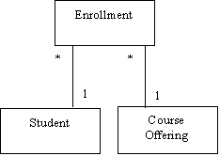
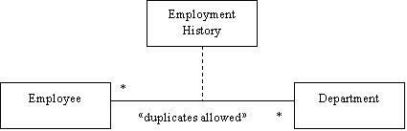
Diagrams Compared
“ERD” – style representation of many-to-many relationship
UML diagram showing the same.

Slide 9
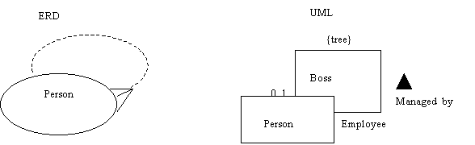
Recursive Relationships
In UML, you can explicitly constrain the relationship in a very precise way. For example, a recursive relationship on the class Employee can be indicated by the constraint {tree} as:

Slide 10
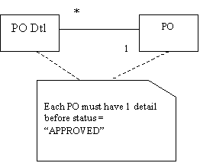
Comments in UML
In the class diagram, comments are graphically represented text objects that can be attached to any UML object. No comments in ER diagrams

Slide 11
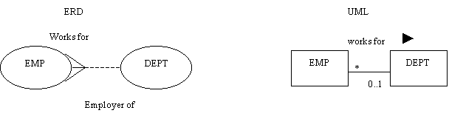
Naming Associations
Rather than naming both sides with verb phrases as in ERDs, in UML, the relationship is named once and a directionality arrow is added, usually pointing from the “many” side to the “one” side of the relationship.

Slide 12
Generalizations in UML
Generalizations in UML are somewhat more flexible than relationships in ERDs.
There need not be only one generalization structure from a given class. You are able to have multiple generalizations operating on the same classes

Slide 13
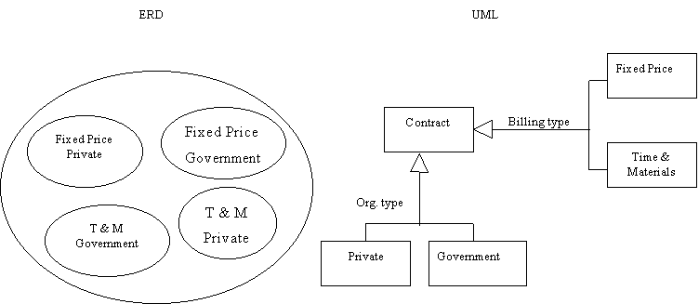
Example Generalization
A consulting contract, which can be Time and Materials or Fixed Cost and independently classified as Government or Private.

Slide 14
Beyond ERD
UML allows for the creation of all sorts of relations types beyond the general Entity or Class relationships
Interaction diagrams: set of objects and their relationships including messages that may be dispatched among them
• Sequence diagrams: time ordering of messages
• Collaboration diagrams: structural organization of
objects that send and receive messages
Activity diagram: flow chart showing flow of control from activity to activity
State chart diagram: models a state machine

Slide 15
UML can show Actions on Objects
returnCopy(c)
call
return
send
create
destroy
okToBorrow()
status
notifyReturn(b)
<<create>>
<<destroy>>

Slide 16
UML can show Links
LibraryMember
+borrowCopy()
+returnCopy()
1
Copy
on loan
0..*
association
class
message
borrowCopy(c)
libMem:LibraryMember
c:Copy
link
object

Slide 17
UML Sequence Diagram
:MEngStudent
1 : getName()
1.1 : name
2: new Student(name)
:Student
3: <<destroy>>
sequence numbers added to messages

Slide 18
Sequence Diagram: Borrow copy of a Book
libMem: LibraryMember
theBook:Book
theCopy:Copy
borrow(theCopy)
okToBorrow
borrow
borrow

Slide 19
Class Inheritance Diagram
Object
Panel
interface
Component
Applet
Container
HelloWorld

Slide 20
Activity Diagram: Process Modeling
Release work order
[materials not ready]
Reschedule
[materials ready]
Assign tasks

Slide 21
Activity Diagram: Parallel Activities
start state
Decompress
fork
Stream video
Stream audio
join
stop state

Slide 22
State Diagram
returned()
returned()
not borrowable
borrowable
borrowed()[last copy]
borrowed()[not last copy]
State diagram for class Book

Slide 23
Implementing UML Models
Subsystem (ERD Term)
A grouping of elements that specifies what a part of a system should do.
Component (UML Term)
A distributable piece of implementation of a system, including software code (source, binary, or executable)
A component can be thought of as an implementation of a subsystem.

Slide 24
Project Work
Your Analysis Document is due soon!
This week (Week Five)
  Discuss Software Testing
  Begin discussions on the Design Specification Requirements
  Review and prepare for the midterm exam
Midterm Exam, very soon!

